Slide 1

Projects Using React.js & Flux
Project 9: SockChat

Slide 2
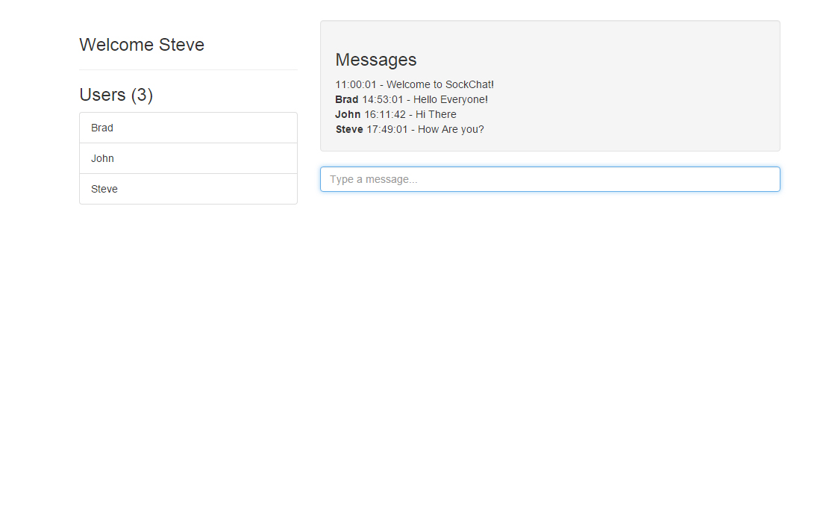
Project Description
A chat application that provides real-time function using websockets

Slide 3
Project Lectures
Section Intro
Webpack & React Setup
Server Connection Setup
Adding Messages
Display messages
Username Functionality

Slide 4
What You Will Learn
How to setup a simple Node.js Express server
How to setup and use socket.io
How to use socket.io-client
Emit Events through websockets

